Slide 1
Everyone Should Own Their Data
By Sam Hanna
Scale20x
March 2023

Slide 2
What is Self Hosting
Self-hosting is the activity of having and administrating your own server, typically at home, to host your personal data and services yourself instead of relying exclusively on third-parties.

Slide 3
Benefits Of Self Hosting
No more privacy concerns
Your data is in your control
You can use open source applications to replace services
Can use old hardware
Easy to install applications

Slide 4
How Can You Self Host
Setup a personal server
Install open source software to sync you data
Setup a VPN to access your server securely and limit access
Using Desktop and mobile apps to keep your data synced
Be sure to make backups

Slide 5
What You Will Need

Slide 6
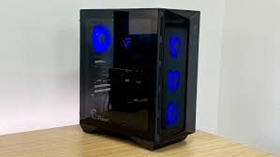
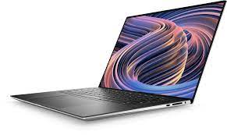
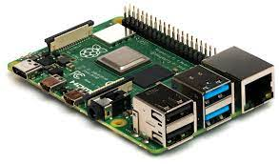
PC/Laptop/Raspberry Pi/VPS
Personal Computer
Laptop
Raspberry Pi

Slide 7
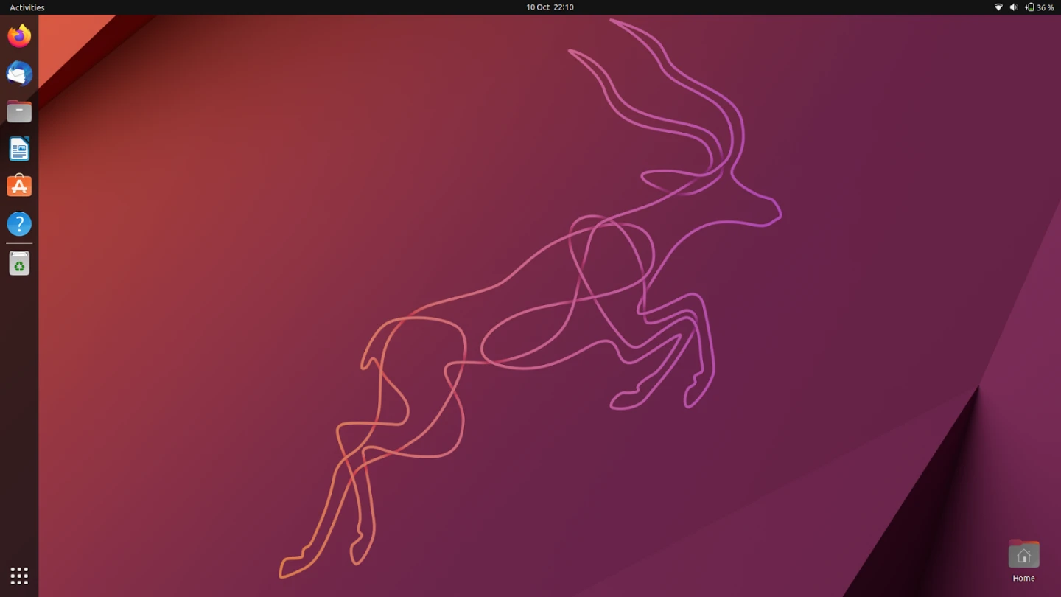
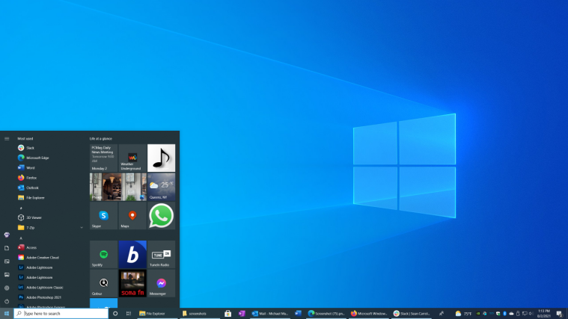
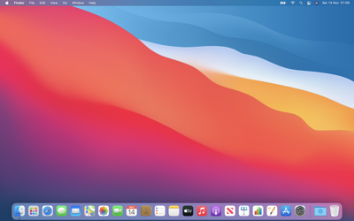
Operating System
Ubuntu
Windows
Mac OS

Slide 8
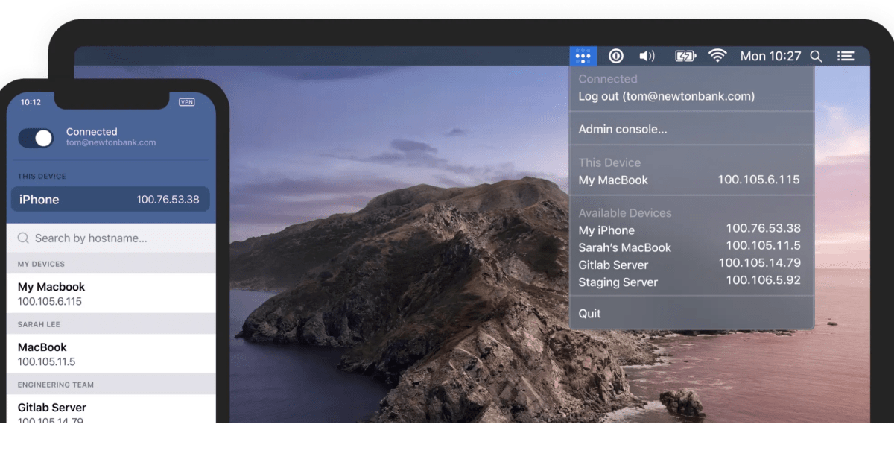
VPN/Tailscale
Tailscale lets you easily manage access to private resources, quickly SSH into devices on your network, and work securely from anywhere in the world.

Slide 9



Domain Name

Slide 10
Tools To Install Software

Slide 11
Docker
Designed to help developers build, share, and run modern applications as containers.
A container is a standard unit of software that packages up code and all its dependencies so the application runs quickly and reliably.
A Docker container image is a lightweight, standalone, executable package of software that includes everything needed to run an application

Slide 12
Docker Compose
is a tool that was developed to help define and share multi-container applications.
With Compose, we can create a YAML file to define the services
with a single command and can spin everything up or tear it all down.

Slide 13
Portainer
Portainer is a (Web GUI) universal container management tool that can work with Docker make the deployment and management of containerized applications and services easier and more efficient without the use of the command line.

Slide 14
Software To Host Our Data

Slide 15
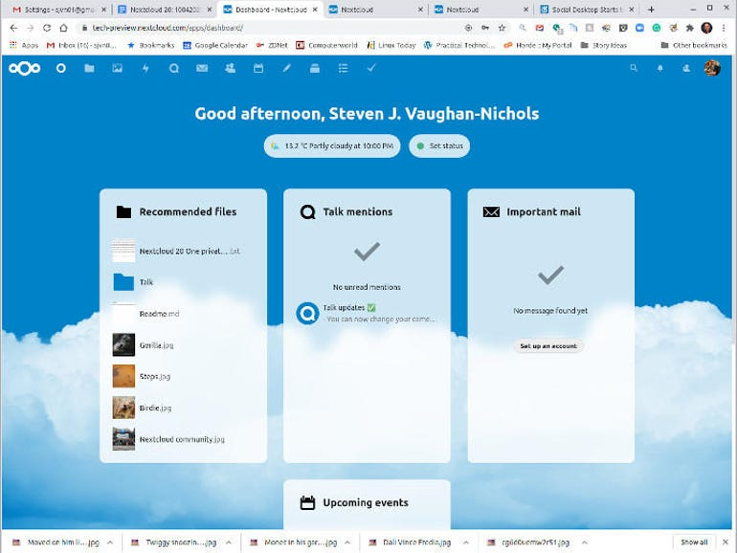
Nextcloud
Nextcloud is a suite of client-server software for creating and using file hosting services. Nextcloud provides functionally similar to Dropbox, Office 365 or Google Drive when used with integrated office suite solutions Collabora Online or OnlyOffice.

Slide 16
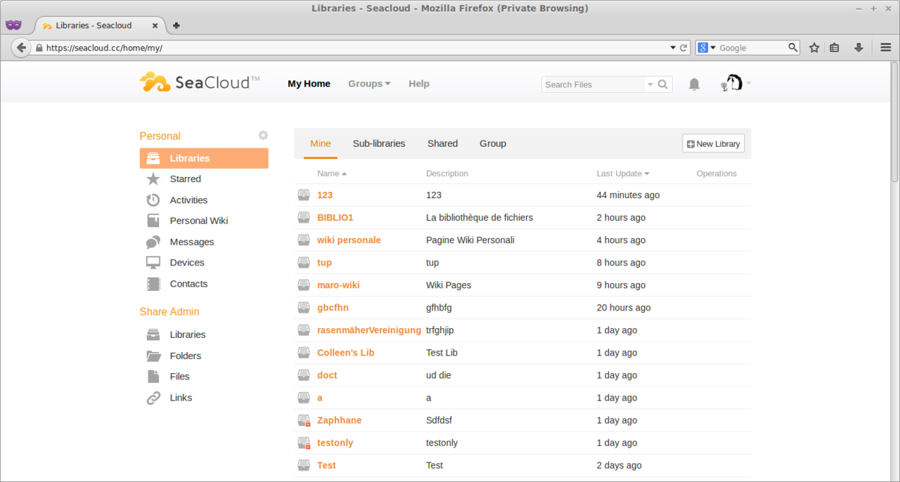
Seafile
Seafile's functionality is similar to other popular file hosting services such as Dropbox and Google Drive. The primary difference between Seafile and Dropbox/Google Drive is that Seafile is a self-hosted file sharing solution for private cloud applications.

Slide 17
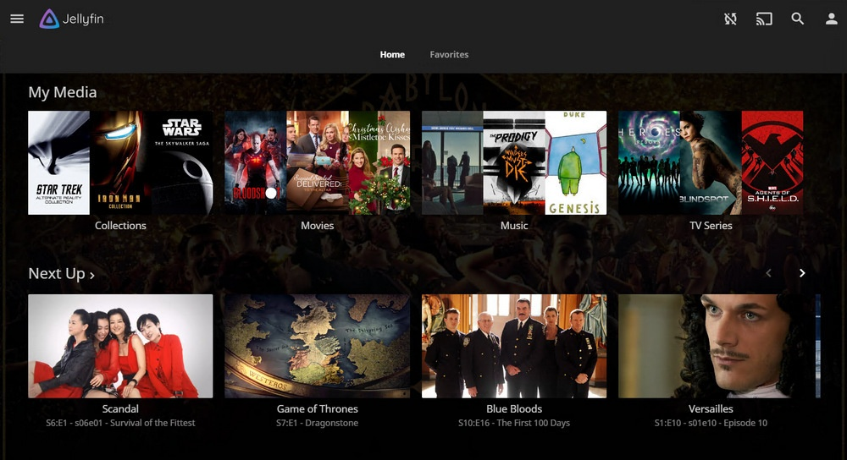
Jellyfin
Jellyfin (similar to plex) is a free and open-source media server and suite of multimedia applications designed to organize, manage, and share digital media files to networked devices.

Slide 18
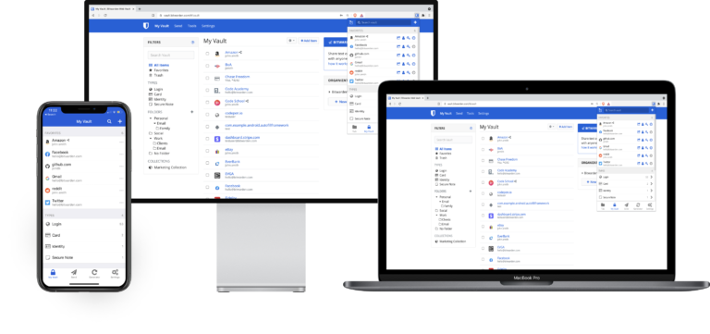
Vaultwarden
Vaultwarden provides a lightweight, single-process, API-compatible service alternative to Bitwarden. Vaultwarden is an open source password management application that can be self-hosted and run on your infrastructure.

Slide 19
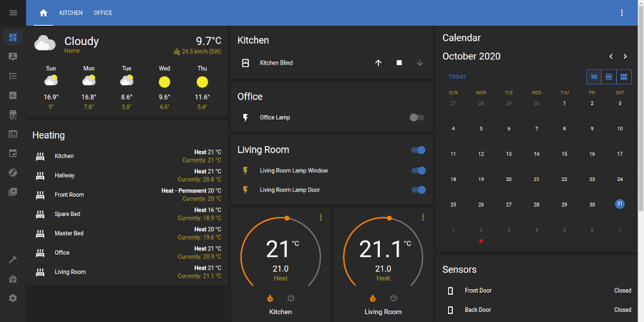
Home Assistant
Open source home automation that puts local control and privacy first.

Slide 20
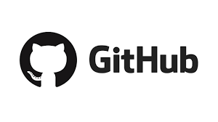


How To Reach Me
https://github.com/samhanna84/samhanna
selfhostingrocks@gmail.com
@samhanna84

